Slide 1


Welcome Pack prepared for
Matilda Hundsdorfer
Brett Davidson
Financial Planner

Slide 2
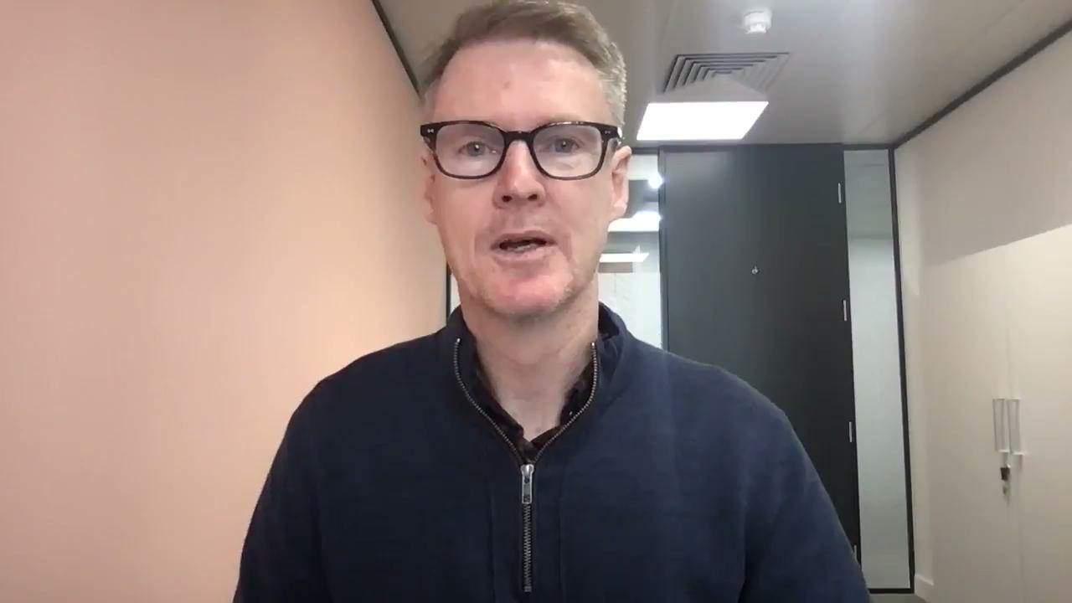

Slide 3

Welcome Pack - What you will find
1
Zoom link for our meeting
2
What to bring
3
How long we will need
4
Advice process overview

Slide 4

Meeting Details
Date : 21st March
Time : 10:00 am
Location : Zoom
Join Zoom Meeting
https://us02web.zoom.us/j/81542084349?pwd=MGFkTXQyY2lMOC83UHJNYWMrV3dtdz09
Meeting ID: 815 4208 4349
Passcode: 003115
Find your local number: https://us02web.zoom.us/u/kbd8lXBZqu

Slide 5

What To Bring
Bring along or have to hand:
Anything you feel is relevant
Investment statements
Pension statements
Monthly or annual income and expenditure (if you know it)
Major monthly expenses (e.g. mortgage, school fees)

Slide 6

We will require about
90 minutes for our meeting

Slide 7

The Advice Process
First Meeting
Discovery
Strategy Presentation
Implementation and Next Steps
(should you wish to implement our advice)
I can be more precise about time frames once I know more about your situation.

Slide 8
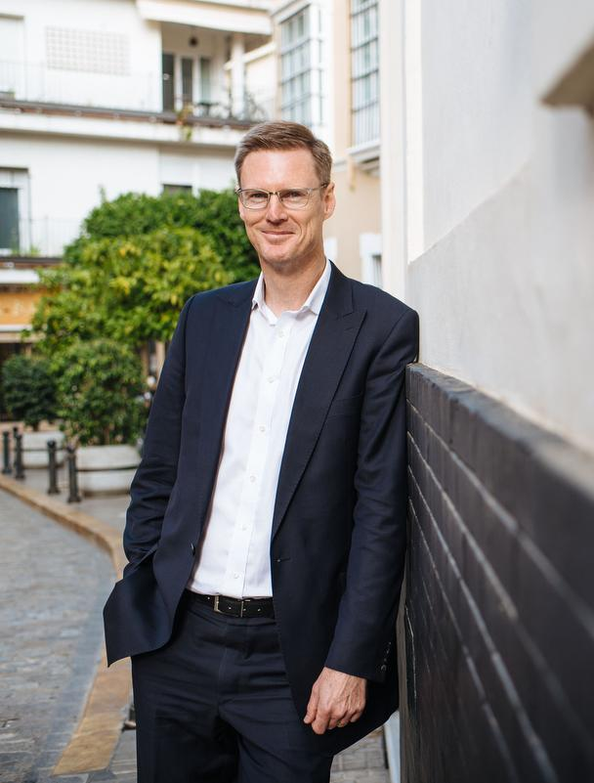
Questions?
If you have any questions email me via brett@xyzfinanical.co.uk or call the office on 0207 000 0000

