Slide 1

Building a robust and practical investment process
12th September 2018
Confidential. Copyright © Albion Strategic Consulting 2018. All rights reserved.
Notes:
The SmarterSuccessTM program from Albion
It consists of three key components:
The first, SmarterInvestingTM provides a robust, evidence-based and thoroughly documented investment process that fully covers the ‘whole-of-market’ obligations of an adviser wishing to be considered to be ‘independent’ as set out in the RDR. It provides the decision-making pathway, and ongoing governenance process, to the portfolio structures suggested and provides the selection criteria, product matrix and in-depth due diligence on products that can be used to inplement the portfolio strategies.
The second, SmarterAdviceTM provides the innovative process and advice storyboard templates that allow advice to be developed and revealed to clients in a very clear, understandable and visual manner, as required as part of the Treating Customers Fairly obligations of advisers. Ongoing goal-progress review templates are also provided.
The third, SmarterInsightTM provides ongoing process governance, updated product due diligence, regular client communication, client education presentations and consultancy support. This ensures that the advisers time is focused on clients and not based on keeping the process and documenst up to date.

Slide 3
Building a framework for making great decisions
Session 1: 11:20 am to 12:30 am

Slide 4
Where are you on your journey?
Zealot!
‘You must be a mug if you don’t do it this way’
‘This is great; it really takes the pressure off worrying about fund selection’
Enthusiasm
Balance
‘Many ways to invest, but some are better for clients than others’
‘Sounds like a good way to do things’
Adoption
Damascene moment!
Maturity
‘No doubt there are some skilled managers but they are scarce and very hard to identify in advance and hard to live with.’
Charles Ellis – “Winning the losers game”
SPIVA Reports
Vanguard – Case for Indexing
Sensible Investing TV
Dimensional Science of Investing
Smarter Investing
Exploration
Comfort
‘It will do the job we ask of it.’.
There must be an easier way.
What about outsourcing?
SEI, multi-asset funds.
Interest
Opposition
Quiet confidence
‘I can pick winners.
Don’t be a loser and lock into certain failure.
Why go down with the market?
How is an adviser earning a fee for doing that?
Here’s an example of great… (Buffett, Bolton, Woodford)’
‘Belief, patience, discipline and fortitude will see you through.’
Notes:
Evolution has dealt human beings a bad hand when it comes to investing. Our emotions get in the way of our logical brains when it comes to making decisions.
We suffer from greed and fear, overconfidence in ourselves, tend to be poor at maths, follow the herd and love a good story – just to name a few of our failings.
In the cold light of day, we all know that to make a profit we need to buy things at a low price and sell them at a higher price. We all love to snap up a bargain…except when it comes to equities!
Often, investors dither around not sure when to invest and only gain the confidence to do so when markets are rising strongly. When markets crash, many get gripped with fear and sell out at the bottom, unable to take the pain.
This results in a strategy of ‘buying high and selling low’, the exact opposite of what we know we should be doing!
If you don’t believe me, look at the slide on the next page…

Slide 5
1. The importance of process
What does process give you?
 | Good outcome | Bad outcome
Good process | Deserved success | Bad break
Bad process | Dumb luck | Poetic justice
Source: J. E. Russo, P. J. H. Schoemaker, (2002), Winning Decisions, New York: NY Doubleday.

Slide 6
1. The importance of process
No right answers - just better and worse solutions
Make well considered decisions
Perception
e.g. Active
Passive
Reality
Evidence
Balance
Confidence
Impact
Decision

Slide 7
1. The importance of process
Investing is simple but not easy
Sensible risks
Market returns
+
Alpha
+/-
-
Financial costs
-
Emotional costs
Outcome

Slide 8
1. The importance of process
Values
Clients
Skills
YOUR APPROACH
Criteria
Breadth
Analysis
ASSET CLASS MENU
Approach
Model portfolios
Suitability
RISK ALLOCATION
Syst-ematic
Judge-mental
Hybrid
RETURN CAPTURE
Short-lists
Criteria
Due diligence
PRODUCT SELECTION
INVESTMENT COMMITTEE
GOVERNANCE LOOP

Slide 9
1. The importance of process
(Scoring 1 = very poor, non-existent, 5 = excellent, robust) | Score
1. Investment philosophy has been defined
2. Things that you need to do well have been identified
3. Decisions based on likelihood of success
4. Asset classes screened against specific criteria – assumptions made
5. Portfolio construction decisions well thought through
6. Robust and tested model portfolios in place
7. Portfolio robustly mapped to risk tolerance/suitability process
8. Comprehensive ongoing product screening and due diligence
9. Strong ongoing governance process in place
10. Fully documented process with client versions/presentation

Slide 10
2. Setting your investment compass
What beliefs do you currently hold?

Slide 11
2. Setting your investment compass
FOUNDATIONS
ENDURING BELIEFS
Let the markets
do the work
Academic research
Nobel Prize winning research and investment theory
Evidence-based investment philosophy
Risk & return
are related
Market efficiency
Empirical data
Be patient
Behavioural
finance
Have confidence
in markets
Be disciplined
Risk factors
Investment theory
Have faith in
capitalism

Slide 12
2. Setting your investment compass – your choices
Time markets
Yes
No
Most DIY individuals
Many IFA’s
Most active managers
Investment magazines
Sunday papers
Yes
Pick stocks
Academics
Many institutions
Evidence-focused,
market-leaders
Investment news letters
Macro hedge funds
No

Slide 13
2. Setting your investment compass – drivers of outcome
‘The investment policy return (allocation weights and market index returns) explained on average 93.6 per cent of the total variation in actual plan return’
Brinson, Beebower and Hood 1986
Reasons for the variation in a portfolio’s return across time
Due to asset allocation
Due to market timing
Due to stock selection
Unattributed
Note:
The 93.6% figure explains how much of a portfolio’s ups and downs over time are due to the underlying return of the passive market exposure that it holds in each asset class i.e. its asset allocation.
Remember, the contribution to the ups and downs from market timing and picking stocks may not necessarily be positive.
In the case of this study, they were negative i.e. deducting returns.

Slide 14
2. Setting your investment compass – market timing
Less than 2% of active UK equity fund managers can time markets⁽¹⁾
Cuthbertson, Keith, Nitzsche, Dirk and O'Sullivan, Niall, (November 2006). "The Market Timing Ability of UK Equity Mutual Funds”. SSRN: http://ssrn.com/
Data series used: MSCI Emerging Markets TR, MSCI UK Index, MSCI World ex UK (net div.), S&P Global REIT, Barclays 5-15 Years TR and UK Treasury Bill Tender 1Month TR Source: Morningtar Direct © 2018. All rights reserved.
Notes:
Forecasting what the near-term future holds is a very difficult task and few have proved that they can consistently make money from doing so.
Take a look at the chart above that shows where each different asset class – from emerging market bonds to cash – has ranked every year for the past 15 years. There is no discernible pattern, yet many investment professionals spend their lives trying to pick the next colour sequence.
Looking at the longer-term picture, we have a greater chance that the relationship between risk and return will become evident and we have a much better chance of being able to rank outcomes.
Long-term portfolio structure is the key to success.

Slide 15
2. Setting your investment compass – zero sum game
Winning trades need losing trades
Market return before costs
(average of all investors)
Winners
Impact of higher costs
Winners
No costs
Lower costs
Higher costs
Losers
Market return less lower costs
(passive funds)
Losers
Market return less higher costs
(active - funds)
Source: Albion Strategic Consulting

Slide 16
2. Setting your investment compass – market efficiency
Return dispersion 15-years to Dec 2017 – top to bottom quartiles
Data source: SPIVA http://us.spindices.com/resource-center/thought-leadership/spiva/

Slide 17
2. Setting your investment compass – chances of success
US active manager underperformance - 15 years to Mid-Year 2017
Data source: SPIVA http://us.spindices.com/resource-center/thought-leadership/spiva/

Slide 18
2. Setting your investment compass - diversification
FTSE 100 stock returns in 2017
Data source: Monthly nominal returns in GBP. Morningstar © 2018 All rights reserved.
Notes:
Forecasting what the near-term future holds is a very difficult task and few have proved that they can consistently make money from doing so.
Take a look at the chart above that shows where each different asset class – from emerging market bonds to cash – has ranked every year for the past 15 years. There is no discernible pattern, yet many investment professionals spend their lives trying to pick the next colour sequence.
Looking at the longer-term picture, we have a greater chance that the relationship between risk and return will become evident and we have a much better chance of being able to rank outcomes.
Long-term portfolio structure is the key to success.

Slide 19
2. Setting your investment compass – diversification
Emerging markets component markets - 1988-2017
Data source: Data source: FE Analytics © Copyright 2019. All rights reserved. 24 MSCI market constituents indices (net div.) and the MSCI Emerging Markets Index (net div.).

Slide 20
2. Setting your investment compass - diversification
Pro-rated versus portfolio level returns 1990-2016
Data source: FE Analytics © Copyright 2019. All rights reserved
MSCI World Index (net div.), Dimensional Global Marketwide Value Index, Dimensional Global Small Index, MSCI Emerging Markets Index (gross div.), S&P Global REIT Index (gross div.), Citi World Government Bond Index 1-5 Years (hedged to GBP), Bloomberg Barclays UK Government Inflation Linked 5-15 Year Bond Index (GBP)

Slide 21
2. Setting your investment compass – managing emotions
US investors – inflows into equity funds – 1998 to 2016
Record buying at top of the market
Buying when markets are going up
Selling after poor performance
Record selling at bottom of the market
Etc...
Source: Investment Company Institute. Copyright. All rights reserved 2017.
Notes:
This graph provides evidence of just how appalling we humans are at investing.
The dark line represents the year-on-year performance of global equities (above the 0% line means that equities are going up and vice versa).
The bars represent the monthly fund flows into equity funds available in the US.
The strong positive returns in the late 1990s, during the tech stock boom, resulted in massive inflows into equity funds. The markets peaked at the start of 2000, the point at which there were record inflows! Investors started selling equities and reached maximum outflows at almost exactly the bottom point of the market, at the start of 2003!
Markets then rose steadily to mid-2007 with very strong inflows. The credit crisis hit with markets falling dramatically from late 2007 to early 2009.
When were there greatest outflows? Yes, you’ve guessed it around March 2009.
Recent research (Morningstar) reveals that investors destroy between 1% to 3% per year by making poor market timing decisions. That’s our fees paid for, right there. In fact, providing discipline and hand holding at tough times is an important part of the value that we bring.
Chasing fund managers is as dangerous as chasing markets.

Slide 22
2. Setting your investment compass
  1. We have a view on how markets work
  2. We have identified other key guiding beliefs
  3. We understand the issues we must focus on
  4. We can back this up with evidence
  5. We can articulate this message to our clients
  6. IT IS DOCUMENTED (briefly is fine!)

Slide 23

3. Don’t try to be a fund manager – be a risk manager
Risk
Performance

Slide 24
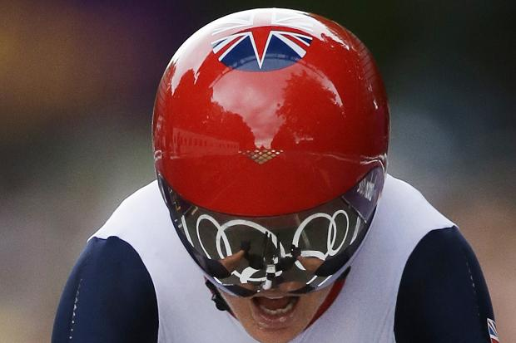

3. Don’t try to be a fund manager – be a risk manager
Track regime
Fitness
Equipment
Rest programme
Wind tunnels
Psychology

Slide 25
3. Don’t try to be a fund manager – be a risk manager
Quick exercise
ACCEPT
AVOID
RISK
REDUCE
TRANSFER

Slide 26
3. Don’t try to be a fund manager – be a risk manager
List here, all the risks that you can think of

Slide 28
3. Don’t try and be a fund manager – be a risk manager
Market-related | Product-related | Manager-related | Client-related
Equity – market Equity – size Equity – value Bond – credit Bond – duration Currency Momentum Quality-junk Security specific Concentration Liquidity Inflation Deflation Social/political Business risk Expropriation Capital controls Legislative change | Fraud Administrative Liquidity Pricing Derivative Opacity Call options Counterparty Hidden costs Custody Lock-in Tax Securities lending Tracking error Tracking difference | Skill level Strategy Execution Manager exit Style drift Concentration Tail risk Tracking error Risk drift Underperformance Fraud Insolvency | Short fall risk Longevity Life events Horizon mismatch Sequence risk Client-specific inflation Taxation Legislative change Behavioural challenges

Slide 29
Building and maintaining great portfolios
Session 2: 1:45 pm to 3:00 pm

Slide 30
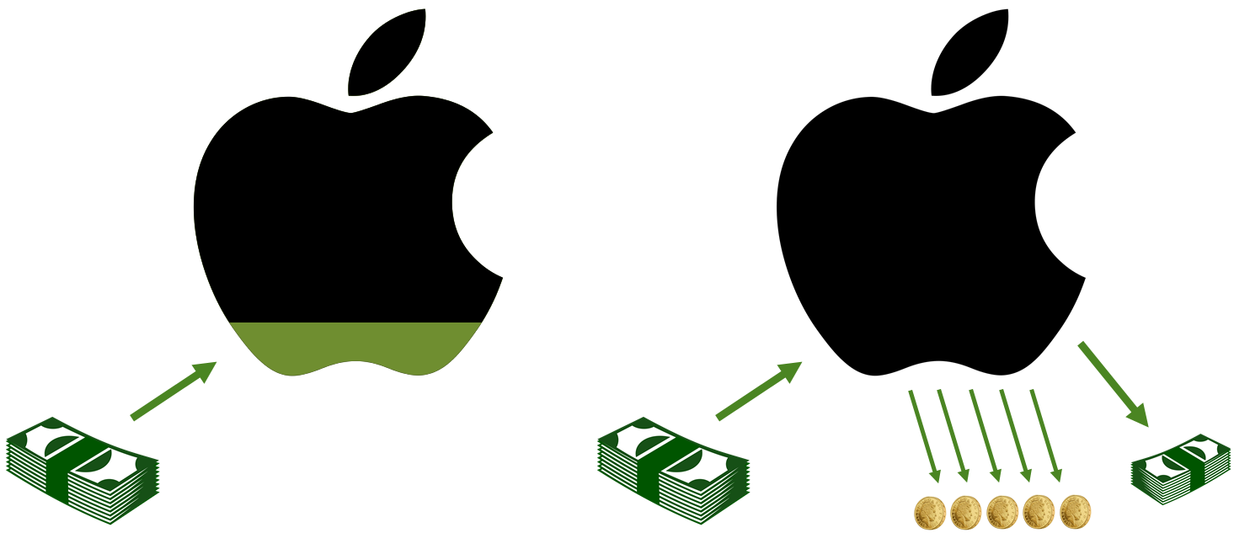
4. Using a risk-based framework for success
OWNER
LENDER

Slide 31
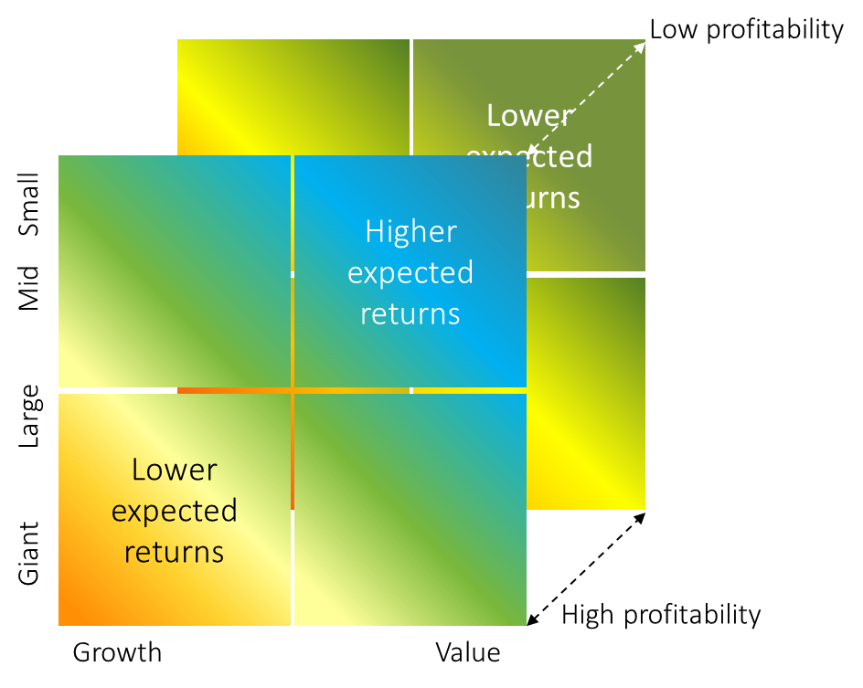
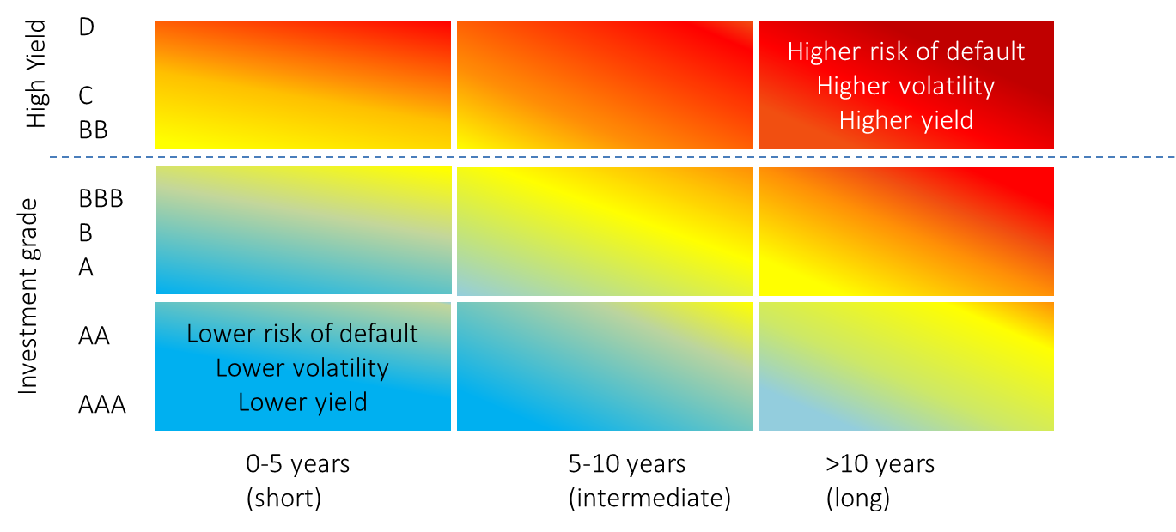
4. Using a risk-based framework for success
OWNER
LENDER

Slide 32
4. Using a risk-based framework for success
OWNER
LENDER
Data source: Monthly nominal returns in GBP. Morningstar © All rights reserved.

Slide 33
4. Using a risk-based framework for success
OWNER
LENDER
Data source: Monthly nominal returns in GBP. Morningstar © All rights reserved. RPI used from Jan-76 to Jan-88, CPI used thereafter.

Slide 34
4. Using a risk-based framework for success
Quick exercise
Cash
Global commercial property
UK equity
Emerging market equity
Commodity futures
Esoteric
(other UCIS)
Short-dated
high quality >AA bonds
High yield
(Junk)
Non-UK
equity
(developed)
Smaller co. equity
Gold
Private equity
UK index linked gilts
Infra-structure
Single country equity
Value equity
Hedge funds
Managed futures
Longer-dated
IG Bonds <AA bonds
Emerging market bonds
Single sector
equity
Smart-beta
Structured products
Life settlement funds

Slide 35
4. Using a risk-based framework for success
  1. Clearly defined source of return
  2. Data provides adequate insight
  3. Risks identified and adequately rewarded
  4. Portfolio contribution clear
  5. Suitable product structure available
  6. Governance budget sufficient to manage risks

Slide 36
4. Using a risk-based framework for success
Decide what is on the menu

Slide 37
4. Using a risk-based framework for success
Equity return enhancers
Emerging market equity
Return
Value equity
Core equity return
UK equity
Smaller co. equity
Non-UK
equity
(developed)
Excluded:
Private equity
Equity diversifier
Global commercial property
Defensive assets
UK index linked gilts
Excluded:
Hedge funds
Commodity futures
Emerging market bonds
Gold
Structured products
Managed futures
Infrastructure
Short-dated
high quality bonds >AA
Excluded:
Long-term cash holdings
Lower quality corporate bonds
Emerging market bonds
Risk

Slide 38
4. Using a risk-based framework for success
Making and using assumptions
Rules of thumb
Common sense assumptions
Historical data
Economic rationale
Academic and investor insights

Slide 39
4. Using a risk-based framework for success
Albion’s central case assumptions
Growth assets | Real Return % p.a. (central case) | Real Return % p.a. (conservative) | Risk %
Global developed equity (market) | 4.5% | 3.5% | 20%
Global developed equity (value) | 6.5% | 4.5% | 25%
Global developed equity (small) | 6.5% | 4.5% | 25%
Emerging markets (market) | 6.5% | 4.5% | 30%
Emerging markets (value) | 8.5% | 5.5% | 35%
Emerging markets (small) | 8.5% | 5.5% | 35%
Global commercial property | 3.5% | 2.5% | 17.5%
Global short bonds (AA, 0-5, hedged) | 1.5% | 1% | 5%
UK index linked gilts (5-15) | 0.5% | 0% | 7.5%
Global inflation linked bonds (hedged) | 0.5% | 0% | 7.5%
Cash | 0.5% | 0% | 3%
Source: Albion Strategic Consulting. Governance Update 13 (refer to for data references)

Slide 40
5. The construction process
Diversify broadly
MODEL PORTFOLIOS
Build and maintain robust portfolios
Take
sensible risks
Avoid cost
leakage
Rebalance
the portfolio
Control
emotions
Manage risks
over time

Slide 41
5. The construction process
Growth assets
  Selections
  Allocations
Construction approach
  Evidence
  Approach
Asset class menu
  Research
  Screen
Model portfolios
  Combine
  Test
  Map
Defensive assets
  Selections
  Allocations
Source: Albion Strategic Consulting

Slide 42



5. The construction process
A whiskey and water approach
Return
Growth assets
Defensive Assets
Risk

Slide 43
5. The construction process
Key decisions
UK
Decision 1
Home bias
Overseas (developed)
Developed
Decision 2
Emerging
Emerging
Broad market
Decision 3
Factor tilts
Factor tilts
Equities only
Decision 4
Other assets
Other assets
Hedged
Decision 5
Currency
Unhedged

Slide 44
5. The construction process - growth assets
Deciding what risks to take is important
Low profitability
Lower expected returns
Higher expected returns
Giant Large Mid Small
Lower expected returns
High profitability
Growth Value

Slide 45
5. The construction process - growth assets
Relative performance: global value stocks vs. the market (1975-2015)
Source: Albion Strategic Consulting
Data: DFA Returns; Global equities – MSCI World Index (net divs.); Global value – Dimensional Global Value Index.

Slide 46
5. The construction process - growth assets
Relative performance: global smaller companies vs. the market (1975-2015)
Source: Albion Strategic Consulting
Data: DFA Returns; Global equities – MSCI World Index (net divs.); Global small – Dimensional Global Small Index.

Slide 47
5. The construction process - growth assets
The numbers provide validation (example only)
 | Structure 1 | Structure 2 | Structure 3 | Portfolio 100
 | 100% UK Equity | 100% Developed World | Structure 2 + 20% emerging markets | Structure 3 + 25% tilts to value and small
Annualised return % | 4.8% | 4.4% | 5.1% | 6.2%
Risk % | 14.1% | 14.8% | 15.7% | 15.9%
Worst 1 year | -35% | -39% | -36% | -35%
Worst 3 years | -16% | -20% | -19% | -14%
Worst 5 years | -9% | -8% | -7% | -4%
Worst 10 years | -4% | -4% | -2% | 1%
R² to Structure 2 | 0.71 | - | 0.96 | 0.94

Slide 48
5. The construction process - growth assets
Allocation
Comfort
Comfort
Allocation
UK
International developed
Global developed
Emerging economies
Market
Value
Market
Small
Equity
Non-equity
Hedge currency to GBP
Do not hedge currency

Slide 49
5. The construction process - growth assets
Global commercial property: rental income from commercial, retail and industrial buildings plus residual values provide diversification of equity risk.
Emerging market equity
(value and smaller companies): higher risks of value and small cap stocks offer the potential for higher returns. Some diversification benefit
Global developed market equity: provides broad exposure to the global economy – captures 100% of developed market capitalisation >6,000 companies.
Emerging market equity: exciting economic growth but carries higher risks than developed market equity, such as weak corporate governance, political instability, and weak rule of law. Expected return is therefore higher. Some diversification benefit.
Global smaller companies: a bit more risky than larger companies with an expected return higher than that of the broad market.
Global value stocks: less financially healthy companies with an expected return higher than that of the broad market.

Slide 50
5. The construction process - defensive assets
Shorter
Decision 1
Duration
Longer
High quality
(AA min)
Decision 2
Credit
Lower
<AA
Nominal
Decision 3
Inflation risk
Real
Hedged
Decision 4
Currency
Unhedged

Slide 51
5. The construction process - defensive assets
The fixed income conundrum
Concerns:
- volatility/losses
- inflation
Emotional tolerance for risk increasing
Concerns:
- equity market risk
Allocation to equities
Role of fixed income:
Low volatility
Protection from inflation
Type of fixed income:
Short-dated bonds
Index linked gilts
Role of fixed income:
Maximum defence against
equity market extremes
Type of fixed income:
Highest quality = gilts
Longer duration

Slide 52
5. The construction process - defensive assets
Deciding what risks to take is important
D
C
BB
BBB
B
A
AA
AAA
Higher risk of default
Higher volatility
Higher yield
High Yield
Investment grade
Lower risk of default
Lower volatility
Lower yield
0-5 years 5-10 years >10 years
(short) (intermediate) (long)

Slide 53
5. The construction process - defensive assets
How far out do you want to sit on the see-saw?
Price
Fall in prices
Duration
Cash
Short
(<5 yrs)
Intermediate
(5-15 yrs)
Long
(15+ yrs)
Yield
Rise in yields

Slide 54
5. The construction process - defensive assets
A worked example of a 2% rise in yields

Slide 55
5. The construction process - defensive assets
Fixed income choices matter
Source: Morningstar. Copyright. All rights reserved 2018.

Slide 56
5. The construction process - defensive assets
Allocation
Comfort
Comfort
Allocation
Short duration
(0-5 years)
Longer duration
(>5 years)
High credit quality
>=AA
Lower credit quality <AA
Nominal bonds
Inflation-linked
Hedge currency to GBP
Do not hedge currency

Slide 57
5. The construction process - defensive assets
Strong defensive properties for both cautious and risk tolerant investors
Global inflation linked bonds: provide protection against unanticipated inflation, through structural linkage of price and coupon to each economies RPI
Duration ~10 years
Credit quality: non-UK govts.
Currency risk: GBP (hedged)
Issues: limited number in issue
Global bonds - role: high quality short-dated bonds provide low volatility compared to equities and diversification of UK yield curve movements.
Duration ~3-5 years
Credit quality: AA average
Currency risk: hedged to GBP
Issues: ~100 bonds
UK index linked gilts: provide strong protection against unanticipated inflation, through structural linkage of price and coupon to UK RPI
Duration ~10 years
Credit quality: UK government
Currency risk: GBP
Issues: limited number in issue

Slide 58
6. Understanding how your portfolios will behave
Building confidence and conviction
  Profiles sheets
  Other ways of helping client to understand the road ahead
Portfolio benchmarking – a minefield
  Who is the target audience?
  What are you looking for?
  What is the message?
Money-weighted vs. time-weighted returns
  Fund-weighted vs. investor related
  XIRR

Slide 59
Albion Portfolio 60
About this portfolio
Over the medium to longer term, the 60% exposure to risks and expected rewards of equity ownership should help to deliver low, inflation-plus returns. The equity risk is balanced by a 40% allocation to high quality bonds. This portfolio could suffer losses of more than 30%.
The accompanying notes must be read in conjunction with this page

Slide 60
Portfolio construction checklist
  1. We are clear on how we build portfolios
  2. We believe that model portfolios are useful
  3. We have tested our portfolios
  4. We understand their likely characteristics
  5. Portfolios are aligned with risk groups (ATR)
  6. Everyone knows when/if/how to use them

Slide 61
Continuing to make great decisions
Session 3: 3:15 pm to 4:30 pm

Slide 62
6. Systematic return capture vs judgemental approaches
Not so clear cut

Slide 63

6. Systematic return capture vs judgemental approaches
Systematic approaches - reason over hope
  In summary
  Disciplined/systematic
  Trading is a less-than-zero-sum game
  Costs matter – minimise them
  Capture full reward for taking market risks
  Works well: efficient & inefficient markets
  Chances: good
  Evidence: strong, extensive and growing
  Boring, but effective
Systematic management

Slide 64

6. Systematic return capture vs judgemental approaches
Judgemental approaches - hope over reason
In summary
Judgemental/discretionary
Believe markets don’t work that well
Capture > market reward through manager skill
Skill-based returns after costs = valuable
Chances: poor
Evidence: short-term, non replicable, anecdotal
Exciting but flawed
Kudos by association
Judgemental management

Slide 65
6. Systematic return capture vs judgemental approaches
Data: John C. Bogle, (2007) The Little Book of Common Sense Investing, J Wiley & Sons, pp. 80-81. US equity fund data from 1970-2005.

Slide 66
6. Systematic return capture vs judgemental approaches
  1. We have reviewed and recorded the evidence
  2. (We have considered survivorship bias)
  3. (We have made apples-to-apples comparisons)
  4. (We have taken into account luck vs. skill)
  5. Our approach is in the clients’ best interest
  6. We can explain our approach to our clients

Slide 67
7. Fund selection and due diligence
Sufficient scope
Whole of
market
Establish selection criteria for each asset class component
Run whole-of-market universe screen (OEICs, ETFs, investment trusts)
Short list
Identify short-list based on screens
Due diligence
& approval
Undertake detailed due diligence using Due Diligence questionnaire
Select 'best-in-class' funds - approved by the Investment Committee
Establish target list of funds for deeper analysis
Monitor best-in-class status across time and replace where necessary
Eliminate funds using qualitative and quantiative assessment
Reject funds that are not best-in-class, primary choice options
Includes both judgemental and systematic products
Rerun screening on an annual basis

Slide 68
7. Fund selection and due diligence
  1. We have established screening criteria
  2. We have a short-listing process
  3. We have identified funds to do full DD on
  4. We have a Due Diligence questionnaire
  5. Products are regularly screened/reviewed
  6. THE PROCESS IS DOCUMENTED

Slide 69
8. Suitability
Willingness
(emotional)
In depth discussion/ resolution
Risk tolerance
Risk capacity
Risk need
Psychometric test
Gauges emotional trade-off between upside outcomes and downside outcome.
Fit-for-purpose.
Careful mapping to portfolios essential.
Need
(financial)
Ability
(financial)
Cash flow modelling
Target rate of return to meet future cash flows.
XIRR
Cash flow modelling
Equity content falls 50%
Bond allocation flat
P60 = -30% - one-off cash out item
Model recovery over set period

Slide 70
9. Good, yet simple governance
The basis of good governance
Leadership
Numeric skills
Logical thinking
Probability framework
Roles
Responsibilities
Accountabilities
Organisation
Committee
(Chair)
Coherent objectives
Vision
Clarity
Commitment
Fortitude
Strong beliefs
Robust philosophy
Disciplined process
Team buy-in
Application
Competitive advantage
Challenging attitude
Robustness of process
Executive team quality
Specific skills
Knowledge
Diligence
Common sense
Application

Slide 71
9. Good, yet simple governance
IC Meeting Agenda

Slide 72
9. Good, yet simple governance
  1. We have a formal Investment Committee
  2. We have an agenda and minute every meeting
  3. We challenge/reaffirm/refine our approach
  4. We review the asset class menu/best funds
  5. We follow up on outstanding items
  6. We keep our process documents up to date

Slide 73



10. Incoming client portfolio analysis
Analysis paralysis!

Slide 74

10. Incoming client portfolio analysis
Just because he got away with it doesn’t mean it wasn’t risky!

Slide 75
10. Incoming client portfolio analysis
What we believe in
Copyright © 2018 Albion Strategic Consulting. All rights reserved.

Slide 76
10. Incoming client portfolio analysis
What opportunities does this provide you with?
  To explain what you believe in
  To explain that performance is delivered by structure
  To talk through the weaknesses of the current structure
  To educate the client in what a ‘good’ portfolio structure looks like
  Justify why moving them to your CIP makes sense, despite performance
  Let them know you are invested alongside them

Slide 77
10. Rebalancing portfolios
A core risk management strategy
‘The fundamental purpose of rebalancing lies in controlling risk, not enhancing return. Rebalancing trades keep portfolios at long-term policy targets by reversing deviations resulting from asset class performance differentials. Disciplined rebalancing activity requires a strong stomach and serious staying power.’
David Swensen, CIO Yale University Endowment
Rebalancing helps to reduce downside outcomes (Dec 1975 to Dec 2015)
Jan-75 to Dec-15 | No rebalancing (A) | Annual rebalancing (B)
Maximum equity exposure | >70% | ~50%
Return % p.a. | 9.4% | 9.6%
Growth of £100 | £3,660 | £3,860
Risk % | 9.7% | 7.8%
Worst 1 year % | -19.4% | -12.4%
Worst 3 years (cumulative) % | -10.3% | -5.6%
Worst 5 years (cumulative) % | -2.6% | 0.0%
Data source: Morningstar. MSCI World Index (net div.), FTSE British Government up to 5 Years. Rebalanced annually – no costs deducted.

Slide 78
10. Rebalancing portfolios
Issues
  Advisory vs. discretionary
    Capital requirements
    Reporting
    Qualifications
    VAT
  How often
    Annually
    In exceptional circumstances – growth/defensive moved by 10%
  When
    All on a specific date, provided no discretion (same strategy and funds as original advice)
    Pre-agreed in writing with the client (in client agreement) – check with your compliance!
    ISA/SIPP/Offshore bonds easy
    GIA has CGT issues
      Harvest GCT – its and important part of the value you deliver
      Bed and ISA
      Consider alternative funds for bed and breakfast
      Manage individual CGT issues
      Need a process for confirming CGT issue outside of the portfolio
    Or at the time of the annual review

Slide 79
smarterportfoliosTM
A risk-focused approach to investing
CONFIDENTIAL © Copyright Albion Strategic Consulting 2016. All rights reserved.
© Albion Strategic Consulting 2010. All rights reserved.

Slide 80
Our investment philosophy and process.
The foundations of a successful investment experience.
Let the markets
do the work
The future
Now
Diversify broadly
STEP 1:
Establish an evidence-based investment philosophy
STEP 2:
Build and maintain a robust portfolio
Assets
to fund
your lifestyle goals
Your investable
assets
Risk & return
are related
Be patient
Take
sensible risks
Avoid cost
leakage
Implementation
Have confidence
in markets
Be disciplined
Rebalance
the portfolio
Control
emotions
Have faith in
capitalism
Manage risks
over time
Foundation:
Nobel Prize winning research and investment theory
STEP 3:
Provide ongoing governance via the Investment Committee
Market efficiency
Empirical data
Reaffirm or
revise process
Challenge the
process
Ongoing review
Market
risk factors
Behavioural
finance
Screen for
new funds
Review the
Portfolio structure
Investment theory
Review the
incumbent funds

Slide 81
Our investment philosophy and process.
 | The process of investing Investing is the simple - but not easy - task of delaying consumption today in order to build reserves of future consumption. It is the process of owning sensible financial assets that will provide greater future wealth than simply holding cash deposits. This extra return comes with extra risk, usually experienced in a bumpier return ride, which may include falls in portfolio value.
 | Evidence is the foundation stone of a robust investment process We believe that investing is more science than art, which requires a robust empirical and theoretical foundation. Nobel prize winning theory and academic evidence sit at the heart of our process. This theory and evidence is always evolving, which may drive changes to our philosophy and portfolios over time.
 | Our investment philosophy acts as a compass Having an evidence-based set of enduring principles provides a framework for making rational investment decisions. Sticking to these philosophical principles improves the chances of a successful outcome. These timeless rules make investing far simpler, but never easy.
 | Portfolio structure is everything A robust portfolio structure should help an investor to weather any storms that come his or her way. It should capture only risks that are understood and contribute something positive to the portfolio. Maintaining the integrity of the structure - through regular rebalancing - is important.
 | Ongoing oversight and management of portfolio risks is crucial Our investment process is not a ‘set-and-forget’ process, but an evolving journey through time. Keeping on top of the risks in portfolios – and the wider investment process - is the role of the Investment Committee. Change is not made for change’s sake, but only when the evidence suggests that the portfolio can be improved.
 | Investment outcomes vary, hopefully within an acceptable range There are no certainties in investing, but a good process improves the chances of a successful outcome. A sound philosophy, a well-structured portfolio and ongoing risk oversight all contribute to success. Understanding the impact, on your goals, of different possible investment outcomes can be very valuable.
Your investable
assets
Nobel Prize winning research and investment theory
Establish an evidence-based investment philosophy
Build and maintain a robust portfolio
Investment Committee & ongoing governance process
Assets
to fund
your lifestyle

Slide 82
Managing you and your portfolio
Staying in it to win it!
Data source: Albion Strategic Consulting. Financial Express © 2018. MSCI ACWI (net div.) in GBP 1/1999 to 2/2018.

Slide 83
The value we add
There is far more to success than just setting up the portfolio
Investor challenges over time
Weak structures & thinking
Fads, bad products & temptations
Market extremes
& emotions
Risk drift & uncertainty
Time-consuming
& boring
Structure portfolio skilfully
Maintain portfolio integrity
Help avoid
emotional
mistakes
Provide rebalancing discipline
Unburden clients of admin
Our value
Skill & insight
Risk management
Guidance and composure
Fortitude and process
Teamwork & systems
What we bring to the table

Slide 84
Process checklist
And finally…

Slide 85
Your investment process checklist
  1. Rigorous evidence based process
  2. Clear decision pathway that leads to portfolio holdings
  3. Identified and closely managed investment and other risks
  4. Clearly articulated and referenced documentation
  5. Diversified at each level
  6. Cost aware – with clear explanations
  7. Process aligned with the firm’s governance budget
  8. Suitability of portfolio risk budget selection for the client
  9. Consistently implemented across all clients – same experience
  10. Flexible within a controlled framework
  11. Ongoing, challenging and recorded governance process

Slide 86
Important notes
Authorisation and your obligations
  Albion is not authorised by the FCA to provide advice or to make arrangements in investments (or carry out any other regulated activity) and the provision of any services, presentations, articles or any other outputs of any kind by Albion should not be construed as carrying on any such regulated activity.
  Your firm is responsible at all times for compliance with FCA Rules and is ultimately entirely and solely responsible for delivering advice to your clients.
  Data source and licence:
  © Morningstar 2018. All rights reserved. Use of this content requires expert knowledge. It is to be used by specialist institutions only. The information contained herein: (1) is proprietary to Morningstar and/or its content providers; (2) may not be copied, adapted or distributed; and (3) is not warranted to be accurate, complete or timely. Neither Morningstar nor its content providers are responsible for any damages or losses arising from any use of this information, except where such damages or losses cannot be limited or excluded by law in your jurisdiction. Past financial performance is no guarantee of future results.

