Slide 1
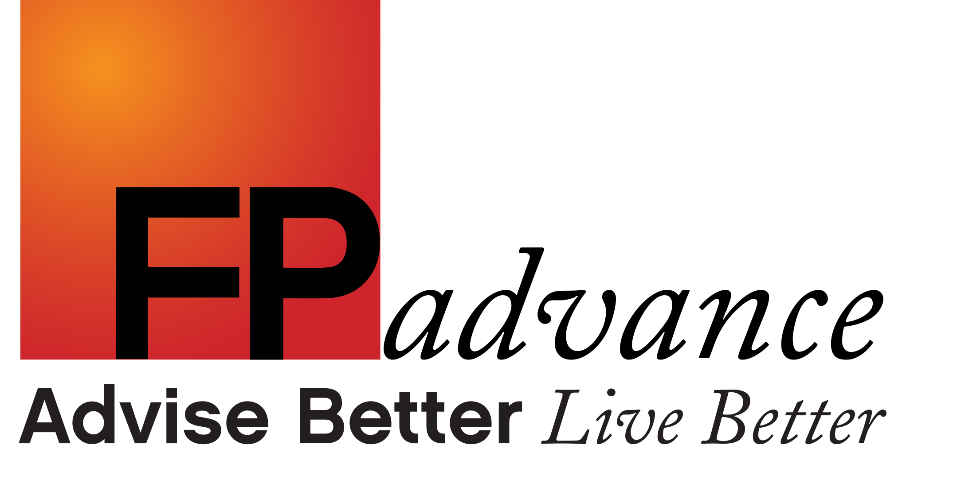
Uncover
Your Business Potential
Brett Davidson Founder

Slide 2
Uncover
Your Business Potential
Welcome
Course Recap
Review of day 11

Slide 3
UYBP Course Recap
Here’s what we’ve covered:
The Clarity Questions
The Business Plan - where are you headed?
Level 10 Meetings - the key to execution
Quarterly MI Spreadsheet - the feedback loop (it’s got to show up in the numbers)
The Business Management Process - a virtuous circle for growth
Quarterly Business Reviews - staying focused and on track

Slide 4
Making It All Work
PLANNING
A Clear Vision
(The Business Plan)
An Achievable Operational Plan
(The Business Plan)
Rinse & Repeat
Execution
90 Day Rocks
(The Business Plan)
Executing Plans
& Solving Issues
(The Weekly Meeting)
Communication
Well Communicated
(State of the Nation Briefings)
Feedback
Profitability Ratios, Productivity Ratios,
Client Selection Ratios
(The Quarterly MI Spreadsheet)
Quarterly Reviews
(Review Business Plan, Rocks, MI and progress toward goals)

Slide 5
UYBP Course Recap
Here’s what we’ve covered:
Client Segmentation - Who do you serve? Who do you love to serve?
Your Ideal Service Proposition - What you deliver
The Client Experience - how you make them feel
Pricing Your Service Perfectly - for good value and profitability
New Client Engagement Process - great questioning skills
The Annual Review Process - is everything going to be alright?
Staff Recruitment, Training & Development - assembling the team

Slide 6
UYBP Course Recap
Here’s what we’ve covered:
The Investment Proposition - simple and effective
Leadership - 9 lessons in leadership from US Navy SEALs
Delegating and Elevating - doing what only you can do
Professionally Branding & Marketing Your Business - style and substance
Working With Professional Connections
Moving To The Next Level - the six core inputs

Slide 7
Moving To The Next Level
Inputs
Business Management
Business Management - mastering this first up, allows for execution.
People
People - are the key to achieving your vision. You can’t do it alone.
Processes
Processes - build a repeatable client experience and trusted brand.
Culture (Values)
Culture & Values - bind it all together.
Client Profile
Client Profile - means there is a flow of new people.
Financials
Financials - let you know how you’re doing in putting it all together.

Slide 8
The Adult
Learning Model

Slide 9
Uncover Your Business Potential
Four levels of learning
Unconscious incompetence
Conscious incompetence
Conscious competence
Unconscious competence

Slide 10
Discussion

Slide 11
Review

Slide 12
What’s working in your business?

Slide 13
What’s not?

Slide 14
Where do you believe you can take your business from here?

Slide 15
Special Guest Presenter
Amyr Rocha-Lima

Slide 16
UYBP Graduate Programme

Slide 17
The Structure
How it works:
Quarterly days (with some more inspiration)
Specific focus on you and your Business Plan for the next 12 months
One Hot Seat session every quarter (bring your biggest issue - receive support)
Bring Rocks, Quarterly MI, and incremental improvements to review and discuss
It’s all about execution

